Slide 1

How to find a planet?
Notes:
Changed slide 3 June 2015

Slide 2
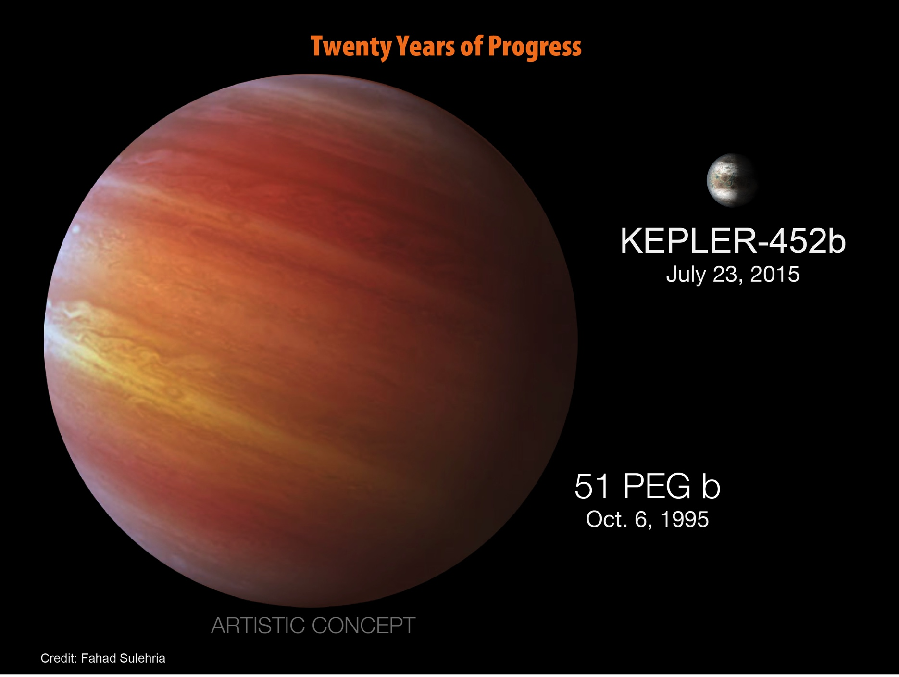

Slide 3
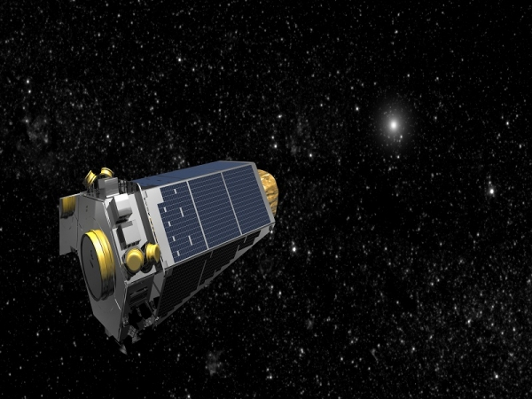

Slide 4
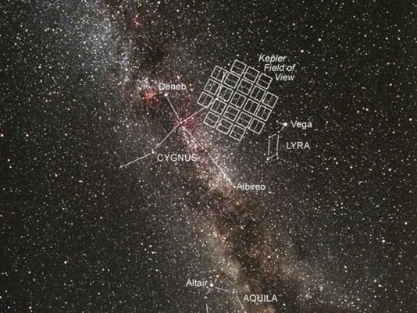

Slide 5
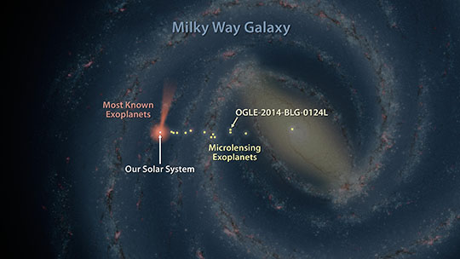
Still in our “neighbourhood”

Slide 6
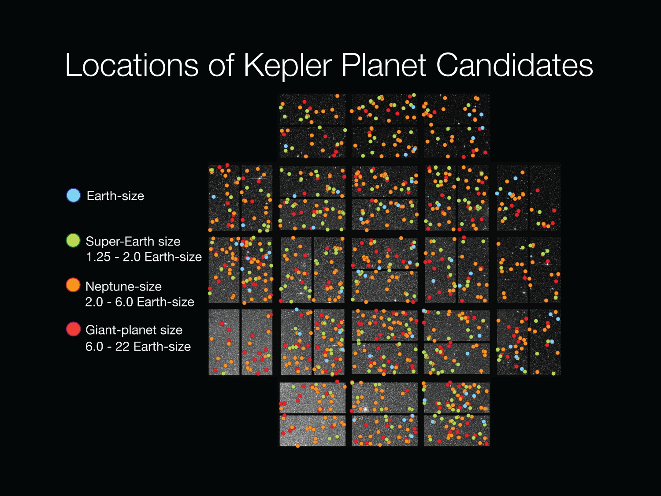

Slide 7
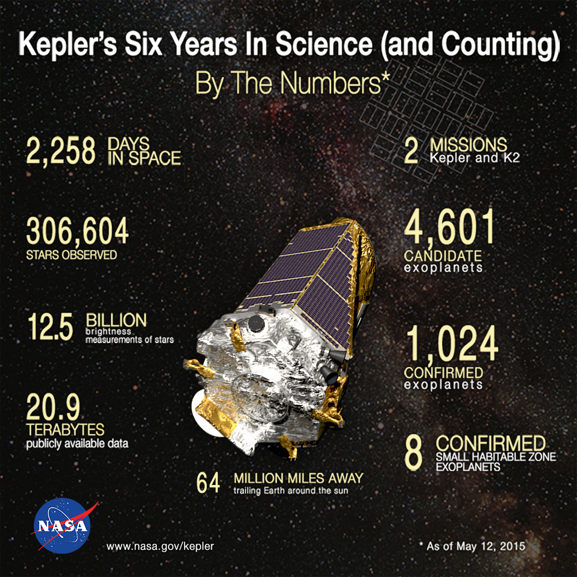

Slide 8
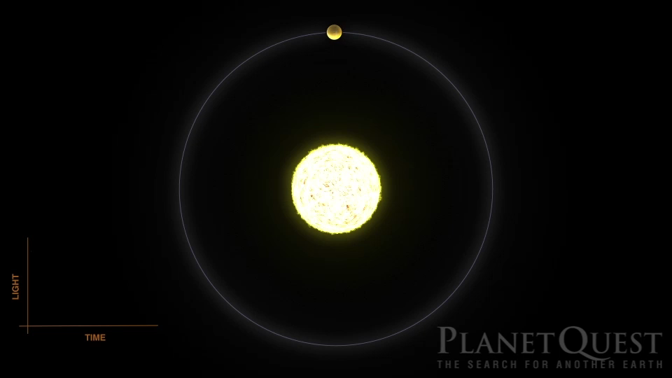
Detect planets as they pass around the star

Slide 9
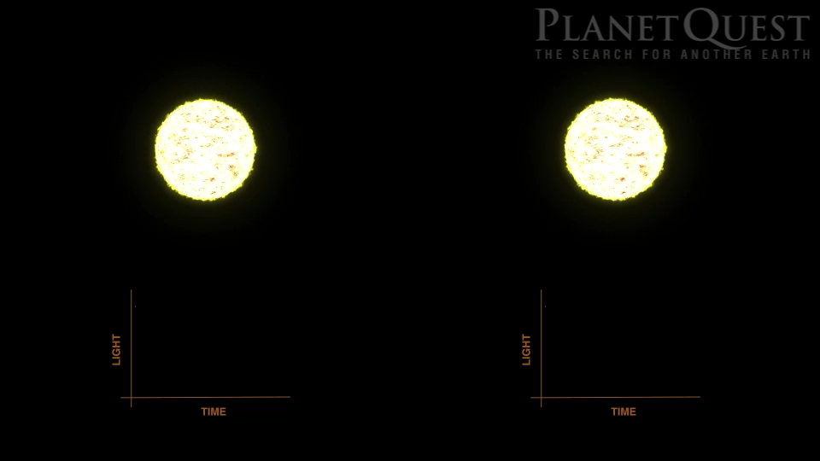
“Larger” Planets cause greater dips

Slide 10
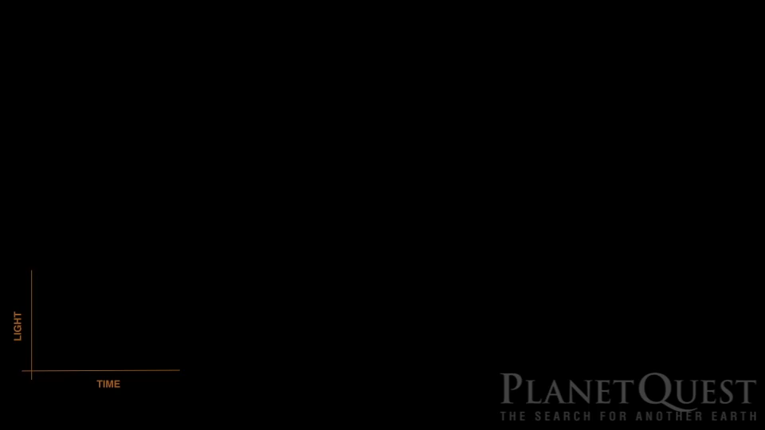
Multiple planets can give interesting combinations

Slide 11
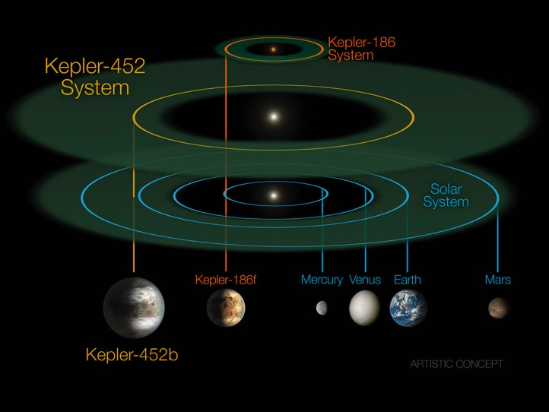
Found systems are small (an artifact of the method)

Slide 12
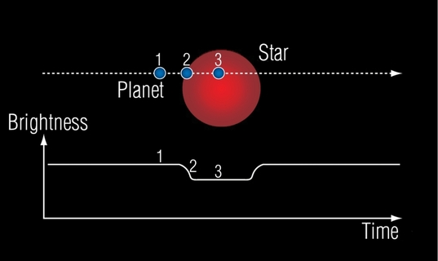
Additional Effects: entry and exit of the disks

Slide 13
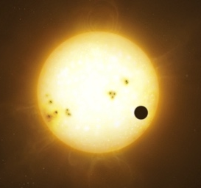
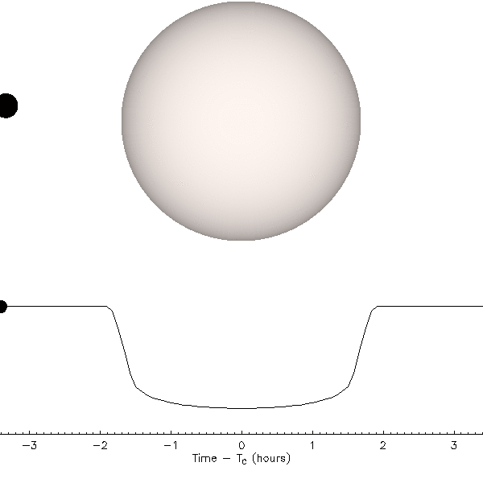
Additional effects: limb darkening

Slide 14
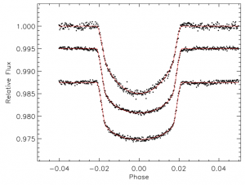
Additional effects: limb darkening

Slide 15
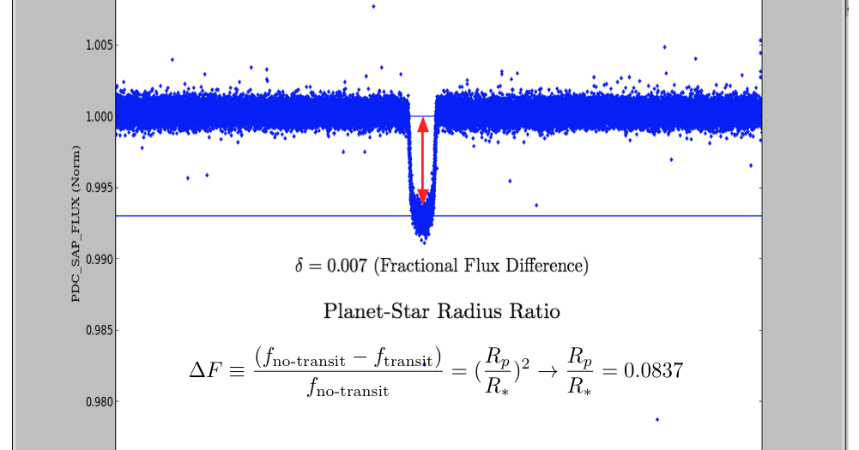
Google is going to be your best buddy!

Slide 16
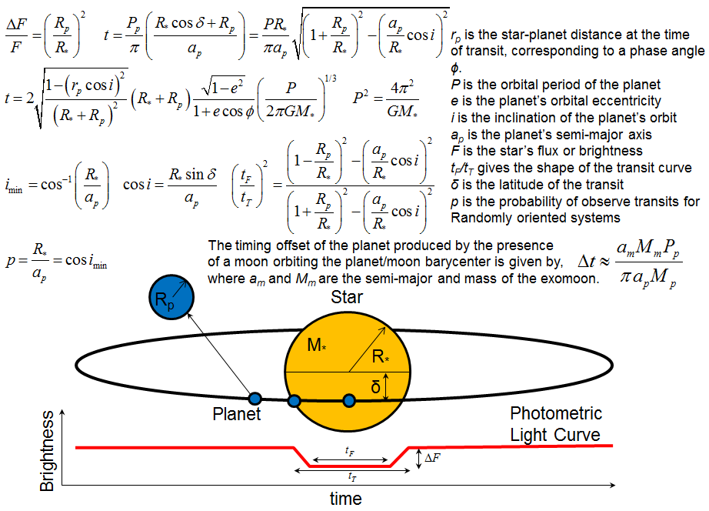
Google is going to be your best buddy!

Slide 17
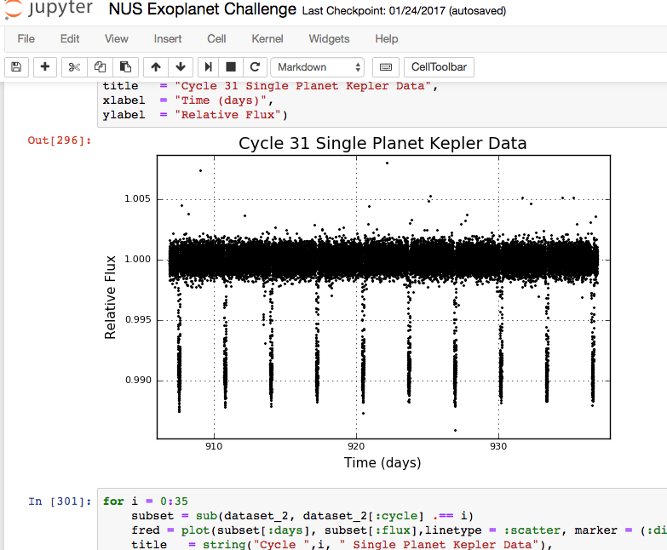
Up to you what tools to use (R, Python, Julia…)

Slide 18
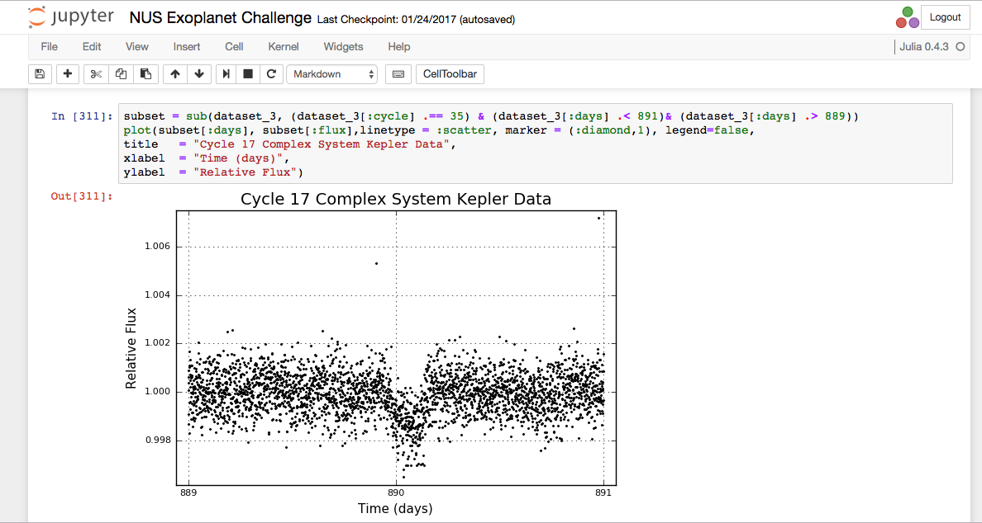
Three datasets of increasing complexity

Slide 19
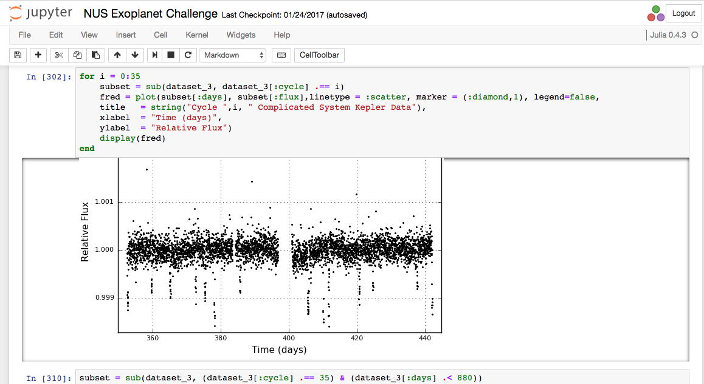
Three datasets of increasing complexity

Slide 20
The challenge is to:
Take data from the Kepler mission.
Work out the period/s for planets in the data sets. You’ll need to decide a method or methods to do. By eye? Fourier? Or something else?
Estimate the relative radius of the planet/s to their host star as accurately as you can, and their orbital distance. You’ll need to decide how you want to do this – by eye, through models
Decide which data you analyse and how ‘sophisticated’ your analysis is
Estimate how well you know these estimates.
Prepare an impactful report out on your method and findings
Real data so real surprises are in it, if you look!

Slide 21
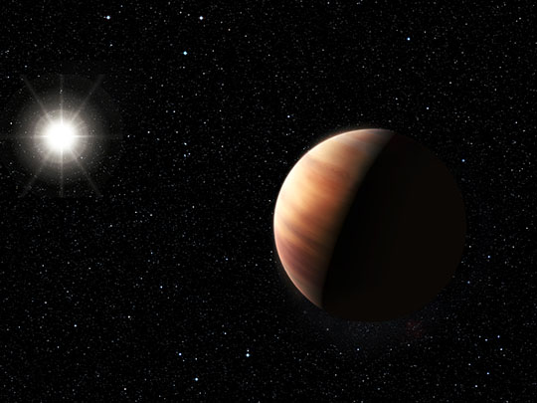
Look for the unexpected!

Slide 22
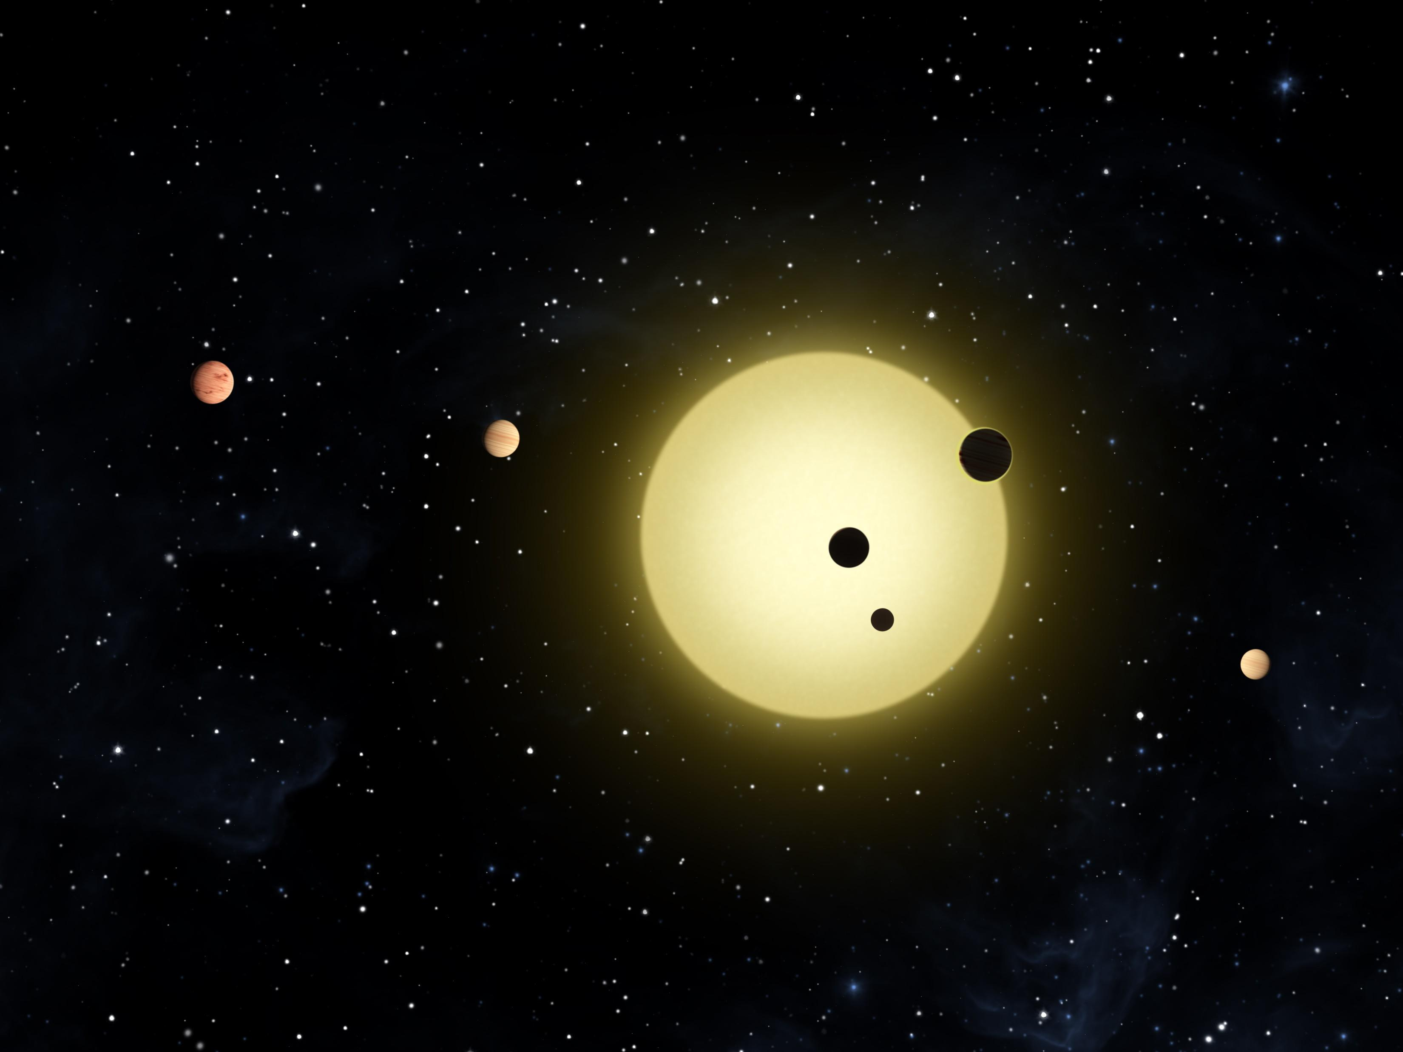
Thank you!

